Slide 1
Responses to Biotic Factors
P 63

Slide 2
Interspecific relationships
Interactions between different species
Competition for the same resources: e.g. food water, space, light
Exploitation
  Predator/prey relationships
  Parasitism
  Plant/animal relationships: Herbivory (grazing, browsing)

Slide 3
Relationship | Species A | Species B
Mutualism | + | +
Commensalism | + | 0
Neutrality | 0 | 0
Antibiosis | 0 | –
Exploitation (predation, parasitism, herbivory) | + | –
Competition | – | –
+ = species benefits, – =species is harmed,
0 = species unaffected

Slide 4
Interspecific co-operative responses

Slide 5
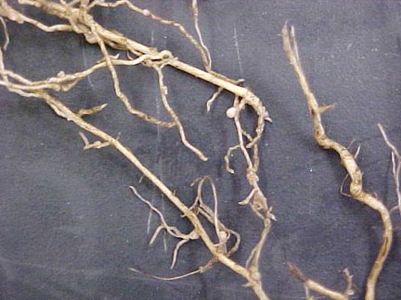
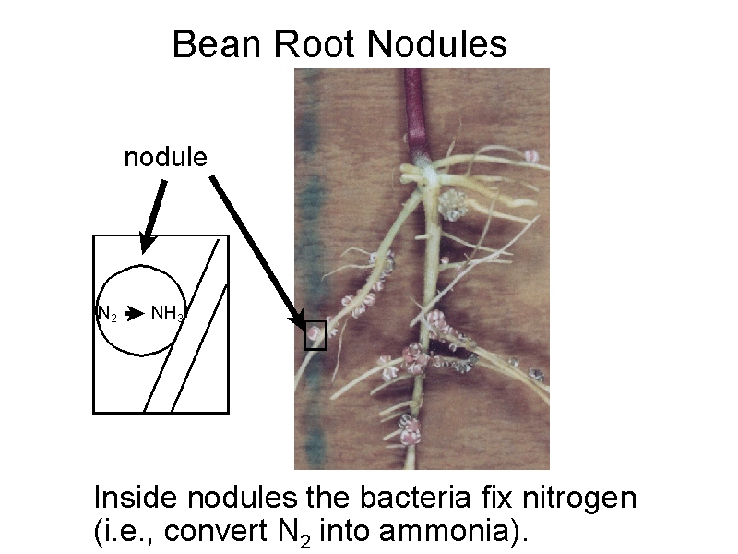
Legume root nodules (pg64)
Mutualism – (2 species help each other)

Slide 6

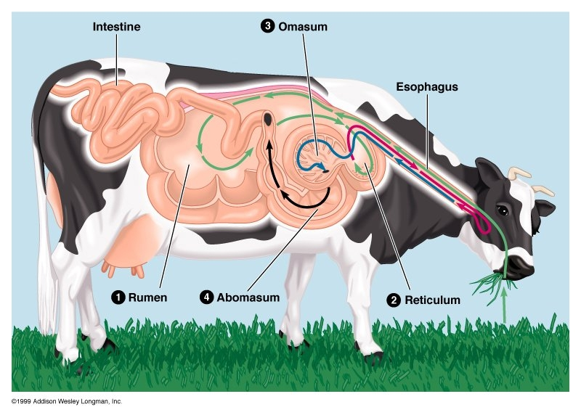

Cellulose digestion
No animals on Earth produce the enzyme to digest cellulose, a major source of nutrition in plant foods. Animals such as ruminants (e.g. cows & sheep) and termites rely on microbes such as bacteria and protozoa to do the job of cellulose digestion.
The rumen of the cow hosts huge numbers of microbes such as the one below

Slide 7
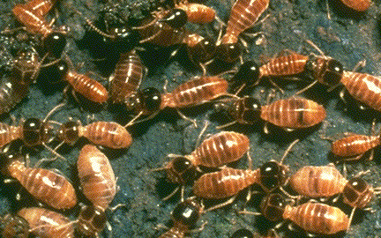
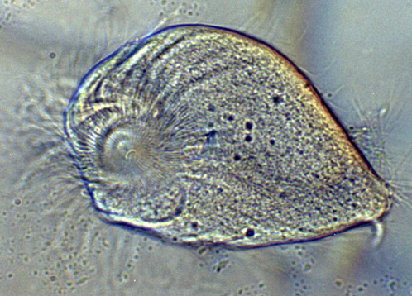
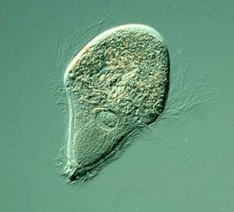
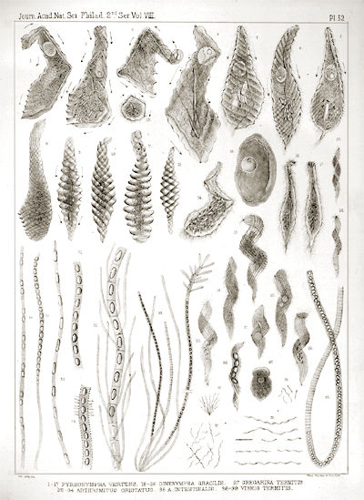
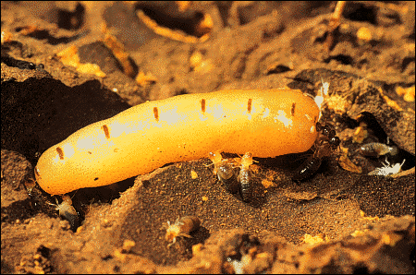
Termites
Termites’ diet (wood) is very high in cellulose. They are totally reliant on a variety of microbes (right) to help them break it down. As with ruminants, the microbes also benefit with a safe place to live and a constant supply of food
A queen termite – (compare her size with the workers attending her)

Slide 8
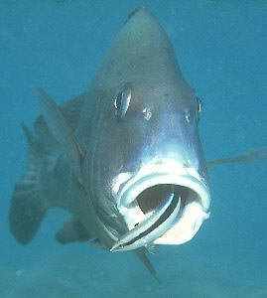
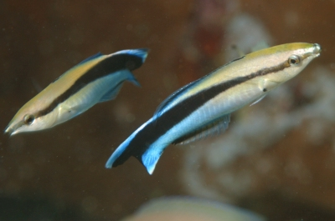
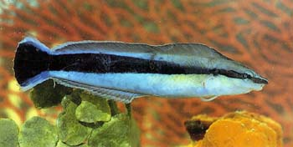
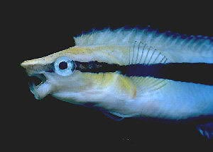
Mutualism – (cleaner fish)
Two cleaner wrasses that remove parasites from the mouth and gills of bigger fish.
A cleaner wrasse taking care of a client.
Both species benefit.
These blennies mimic the wrasse. When the big fish allows them close to clean them, the blenny nips their gills!! (This is not an example of mutualism.)

Slide 9
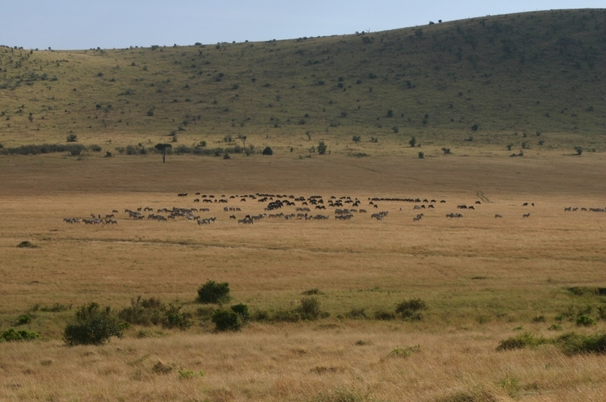
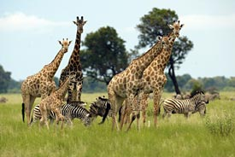
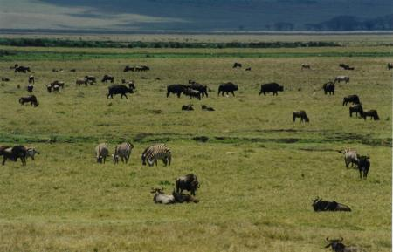
Mixed grazing
Different species grazing together may have differently tuned senses (e.g. sight, hearing, smell) so that together they are more likely to detect dangers.

Slide 10
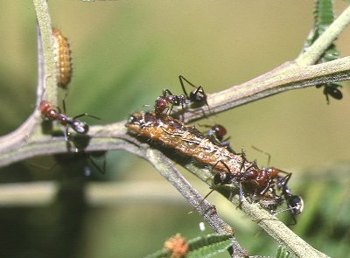
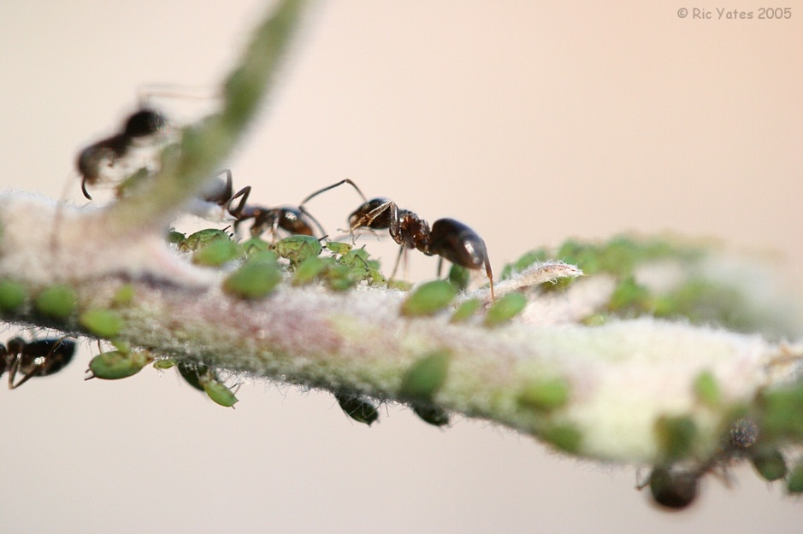
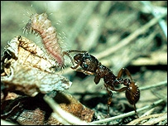
Ants farming other insects
Australian meat ants guard Lycaenid caterpillars against predators such as Bull Ants and birds, and parasites such as wasps and flies. In return for being guarded, the caterpillars offer the Meat Ants nutritious secretions from special organs located at the rear, and along the length, of their bodies. The Meat Ants also appear to direct the caterpillar towards fresh foliage and to herd them around the tree.
These ants are farming aphids for their honeydew.
English ants milk caterpillars of the little blue butterfly. The ants rear the caterpillars in their nest.

Slide 11
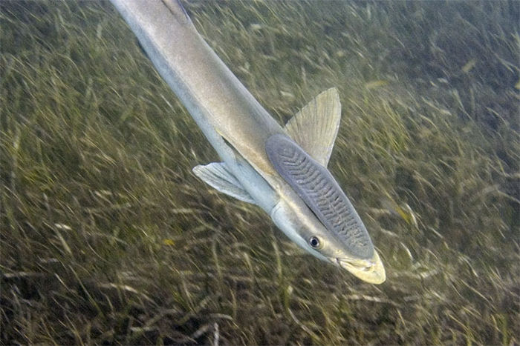
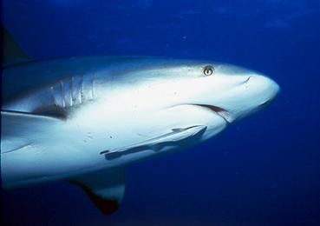
Commensalism
One species benefits, the other is unharmed
The remora has a sucker on its head.
It attaches to larger fish and can scavenge left-overs.

Slide 12
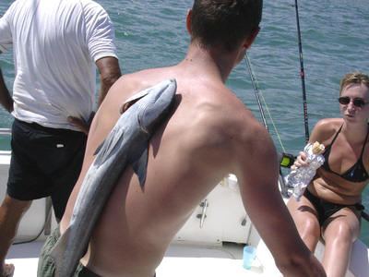
Who’s the sucker?
Some things are better to attach to than others.

Slide 13
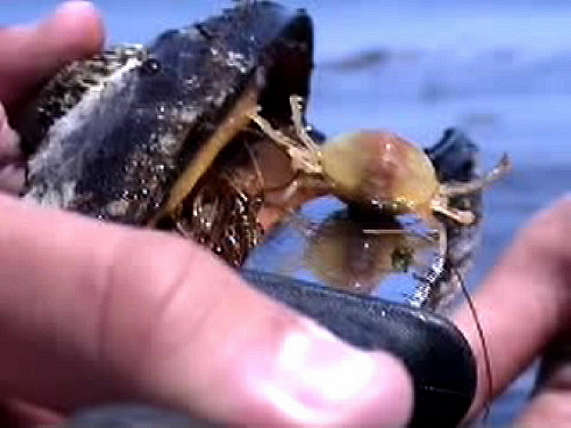
The pea crab
The pea crab hides inside the shell of mussels, supposedly without harm to its host

Slide 14
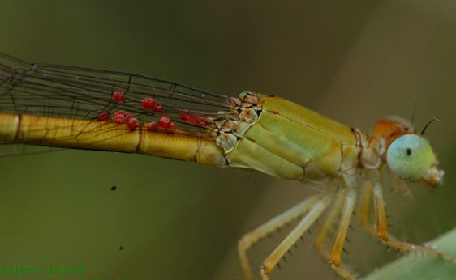
Give us a lift?
The mites below are transported on the damselfly with no harm to the damselfly.

Slide 15
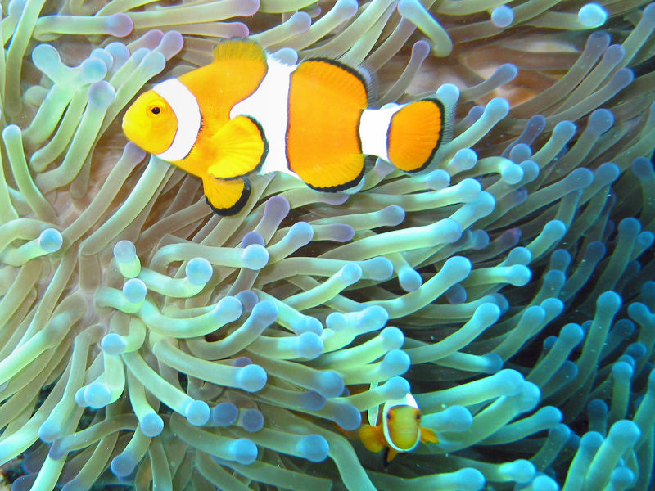
Here’s a well known commensal
The clown fish gains protection from predators by hiding among the tentacles of a sea anemone.

Slide 16
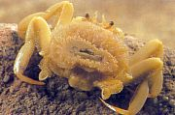
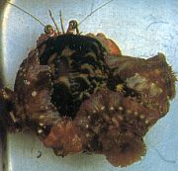
Don’t get crabby about it!
If you’re too big to hang around between the tentacles of an anemone, then you just stick one on your back for protection and camoufage!

Slide 17
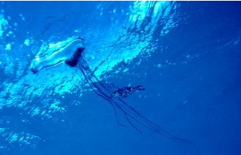
Or you can hang about between the tentacles of a portugese man of war.

Slide 18
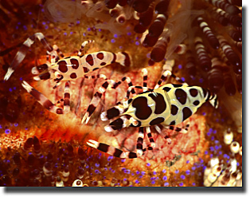
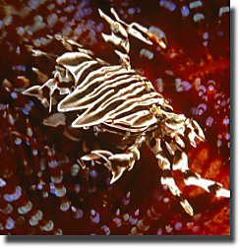
More commensals
Coleman’s shrimp (left) and the urchin crab (below) are both gaining protection by associating with the “fire urchin”
Te Mutu

